Slide 1

Hebbian Learning
Dezhong Peng
Machine Intelligence Lab
http://www.machineilab.org

Slide 2
Outlines
Concept of
  Learning
Learning rules
  Hebbian Learning
  Hebbian Learning to Intelligent Machines

Slide 3
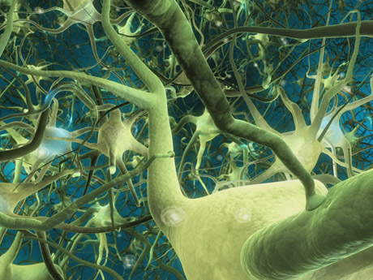
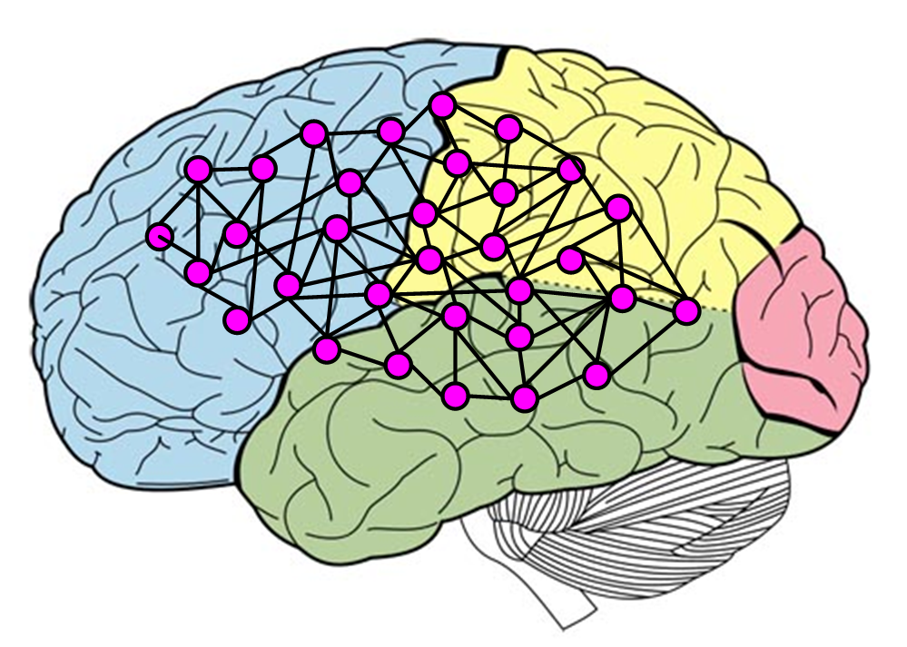
Learning and Neuron Activity
Learning could be explained
by the action of neurons.
Neural Networks

Slide 4
Learning and Neuron Activity
How does a network learn?
Learning is the process of a network changing connection weights among neurons.

Slide 5
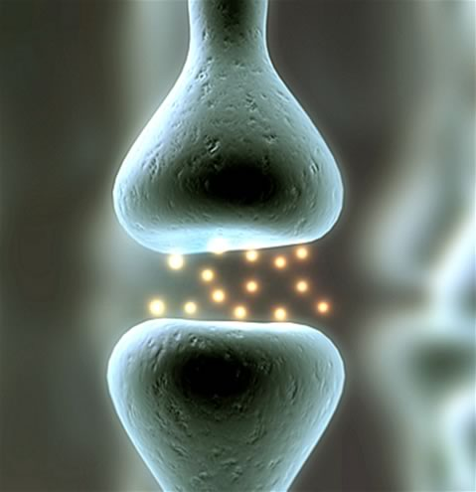
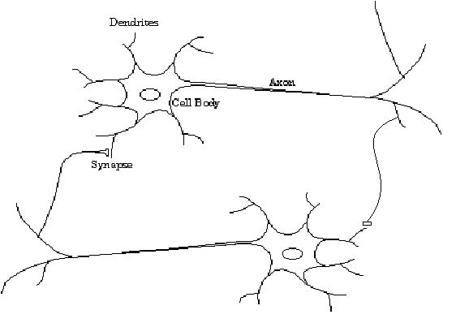
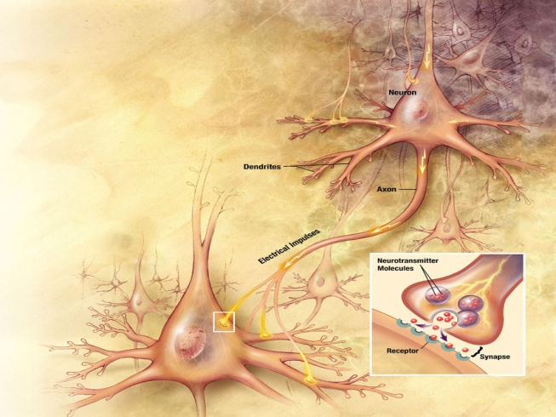
Connection of Neurons

Slide 6
Synapse

Slide 7




























Models of Neural Networks
Connection Weights

Slide 8
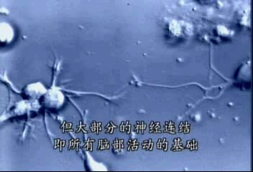
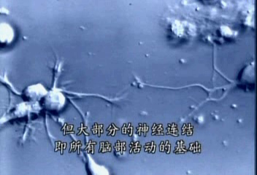
Connection of Neural Networks

Slide 9


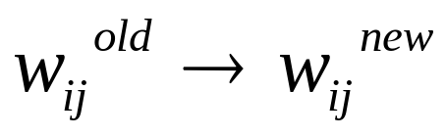
Learning of Neural Networks
Learning is the process of a network changing connection weights

Slide 10
Learning
Where does a neuron store its learned knowledge?
Network connection weights

Slide 11
Learning
Problem: Are there any rules?

Slide 12
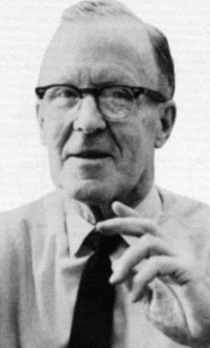
The Hebb Rule
D. Hebb, 1904-1985.
Degree in English, 1925.
Master degree in psychology at McGill University.
Ph.D. from Harvard in 1936.
Moved to Yerkes Lab in 1942.
Published “The Organization of Behavior” in 1949.

Slide 13
The Hebb Rule
The Organization of Behavior
-------Behavior could be explained by the action of neurons.

Slide 14
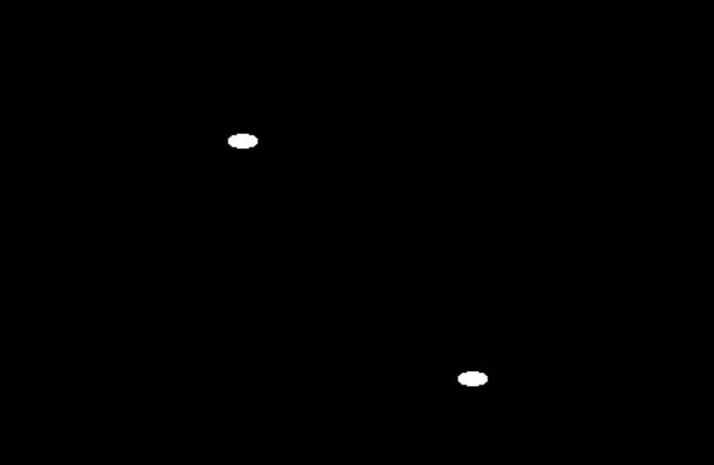
Hebb’s Postulate
When an axon of cell A is near enough to excite a cell B and repeatedly or persistently takes part in firing it, some growth process or metabolic change takes place in one or both cells such that A’s efficiency, as one of the cells firing B, is increased.
D. O. Hebb, 1949
B
A

Slide 15
Hebb Rule
If two neurons of either side of a synapse are activated
  simultaneously, the strength of the synapse will increase.
synapse

Slide 16



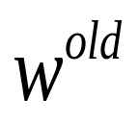
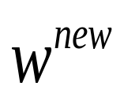
Synapse

Slide 17
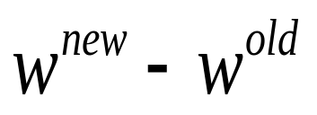
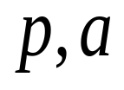
Synapse
If two neurons of either side of a synapse are activated
  simultaneously, the strength of the synapse will increase.

Slide 18
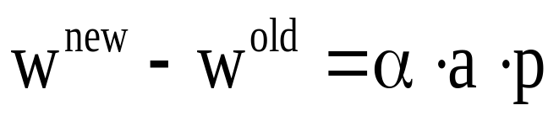
Hebb Rule
If two neurons of either side of a synapse are activated
  simultaneously, the strength of the synapse will increase.

Slide 19
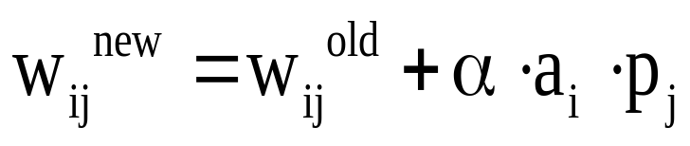
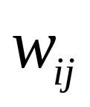
Hebb Rule
Neuron i
Neurons j

Slide 20

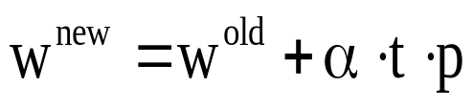
Supervised Learning
Supervised Hebbian Learning
Network output
Target output

Slide 21
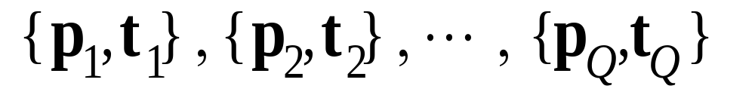
Supervised Learning
• Supervised Learning
Network is provided with a set of examples
of proper network behavior (inputs/targets)
Target output

Slide 22




Unsupervised Learning
• Unsupervised Learning
Only network inputs are available to the learning
algorithm. Network learns to categorize (cluster)
the inputs.
j
i

Slide 23


Hebb Rule
Network output
Target output
Unsupervised Hebbian Learning
Supervised Hebbian Learning

Slide 24
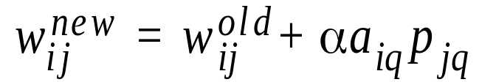
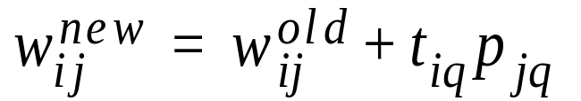
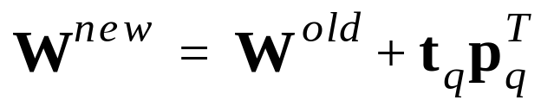
Hebb Rule
Simplified Form:
Supervised Form:
Matrix Form:

Slide 25




Variations of Hebbian Learning
Basic Rule:
Learning Rate:
Smoothing:
Delta Rule:
Unsupervised:

Slide 26




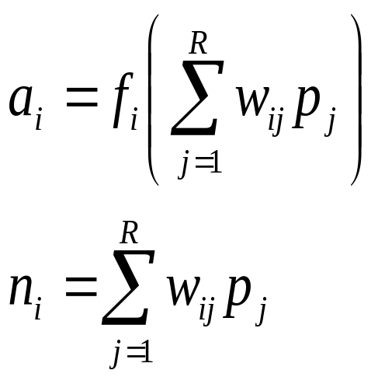







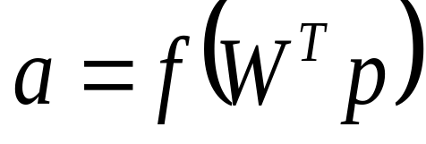

Single Layer NNs Review
Math Model

Slide 27

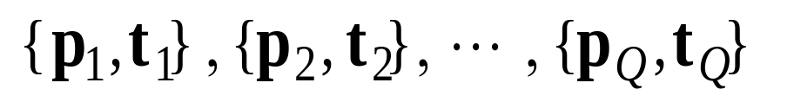
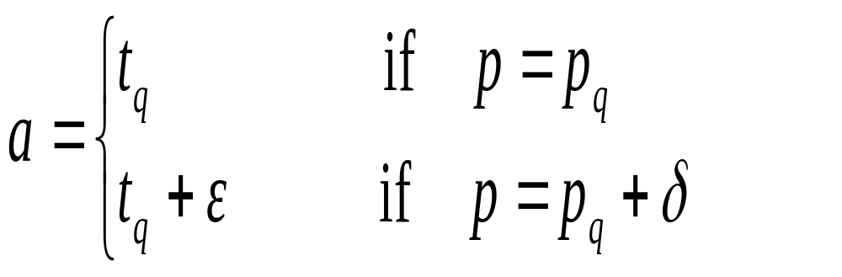



Associative Memory
The task of an associative memory is to learn Q pairs of
  normalized prototype input/output vectors:

Slide 28

Associative Memory
Neural Network
Zhang Yi

Slide 29

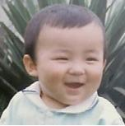
Associative Memory
Neural Network
Zhang Yi
Neural Network
Zhang Yi
Neural Network
Zhang Yi ?

Slide 30
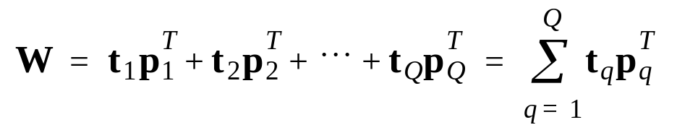
Associative Memory – Learning Rule
Supervised Hebbian Learning

Slide 31
Learning Rule
(Zero Initial
Weights)
Matrix Form:
T
p
1
T
P
=
p
p
…
p
W
p
T
T
1
2
Q
=
t
t
…
t
2
=
P
1
2
Q
…
T
T
=
t
t
…
t
p
1
2
Q
Q

Slide 32
Autoassociative Memory
P1,t1 p2,t2 p3,t3

Slide 33
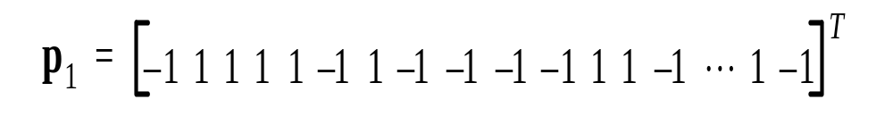
Autoassociative Memory
P1,t1 p2,t2 p3,t3
ffff

Slide 34


Autoassociative Memory

Slide 35
Tests
50% Occluded
67% Occluded
Noisy Patterns (7 pixels)

Slide 36
Example
Consider the following three prototype patterns
P1 P2 P3
Use the Hebb rule to design a network
that can recognize these three patterns. And, find
the response of the network to the pattern P shown bellow.
Is the response correct?
P

Slide 37
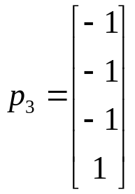
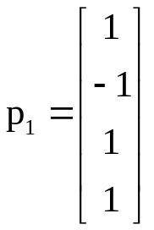
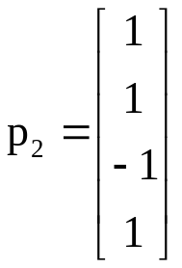
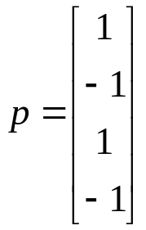
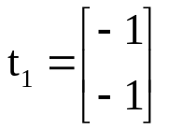
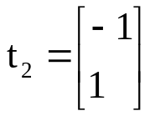
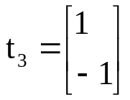
Example
P1
P2
P3
P
Inputs:
Input:
Outputs:
Output: ???

Slide 38
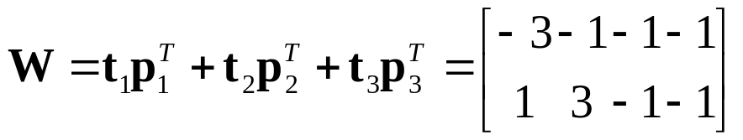
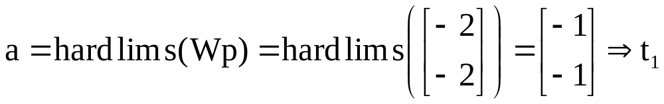
Example

